Slide 1
DBMS SQL Views

Slide 2
In SQL, a view is a virtual table based on the result-set of an SQL statement.
A view contains rows and columns, just like a real table. The fields in a view are fields from one or more real tables in the database.
You can add SQL functions, WHERE, and JOIN statements to a view and present the data as if the data were coming from one single table.

Slide 3
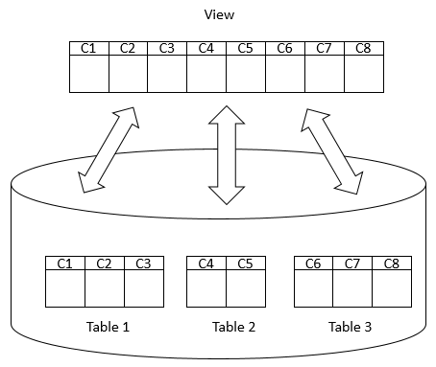

Slide 4
The SQL VIEW is, in essence, a virtual table that does not physically exist.
Rather, it is created by a SQL statement that joins one or more tables.
We can create a view by selecting fields from one or more tables present in the database.
A View can either have all the rows of a table or specific rows based on certain condition.
A View can be created from a single table or multiple tables.

Slide 5
CREATE VIEW Syntax
CREATE VIEW view_name AS SELECT column1, column2, ... FROM table_name WHERE condition;

Slide 6
SQL CREATE VIEW Examples
CREATE VIEW [Brazil Customers] AS SELECT CustomerName, ContactName FROM Customers WHERE Country = 'Brazil';

Slide 7
SELECT * FROM [Brazil Customers];

Slide 8
SQL DROP VIEW Syntax
DROP VIEW view_name;

Slide 9
Example
DROP VIEW [Brazil Customers];

Slide 10
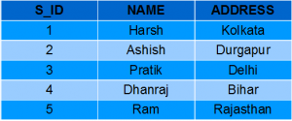
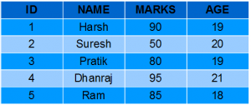
One more example for view
StudentDetails StudentMarks

Slide 11
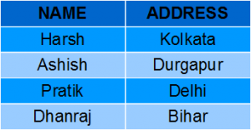
Creating View from a single table
CREATE VIEW DetailsView AS SELECT NAME, ADDRESS FROM StudentDetails WHERE S_ID < 5;
SELECT * FROM DetailsView;

Slide 12
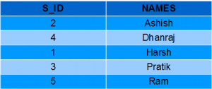
CREATE VIEW StudentNames AS SELECT S_ID, NAME FROM StudentDetails ORDER BY NAME;
SELECT * FROM StudentNames;

Slide 13
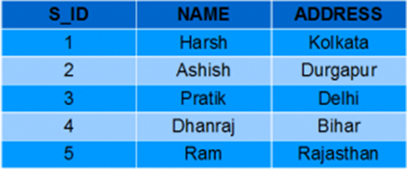
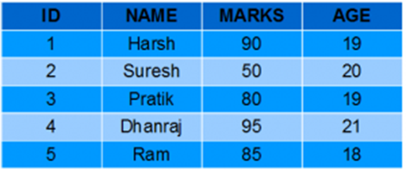
Creating View from multiple tables
CREATE VIEW MarksView AS SELECT StudentDetails.NAME, StudentDetails.ADDRESS, StudentMarks.MARKS FROM StudentDetails, StudentMarks WHERE StudentDetails.NAME = StudentMarks.NAME;

Slide 14
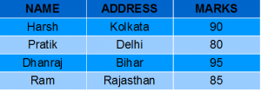
SELECT * FROM MarksView;

Slide 15
DROP VIEW MarksView;

Slide 16
We can use the CREATE OR REPLACE VIEW statement to add or remove fields from a view.
CREATE OR REPLACE VIEW MarksView AS
SELECT StudentDetails.NAME, StudentDetails.ADDRESS, StudentMarks.MARKS, StudentMarks.AGE
FROM StudentDetails, StudentMarks
WHERE StudentDetails.NAME = StudentMarks.NAME;

Slide 17

SELECT * FROM MarksView;

Slide 18
Advantages of views
Security
You can restrict users to access directly to a table and allow them to access a subset of data via views.
For example, you can allow users to access customer name, phone, email via a view but restrict them to access the bank account and other sensitive information.

Slide 19
Simplicity
A relational database may have many tables with complex relationships e.g., one-to-one and one-to-many that make it difficult to navigate.
However, you can simplify the complex queries with joins and conditions using a set of views.

Slide 20
Consistency
Sometimes, you need to write a complex formula or logic in every query.
To make it consistent, you can hide the complex queries logic and calculations in views.
Once views are defined, you can reference the logic from the views rather than rewriting it in separate queries.

Slide 21
Disadvantage of Views
Performance
Sometimes a simple query may take longer time to run. If view is defined by complex multi table query.

Slide 22
View Management
The view should be created by as per standard then it will simplify the job of DBA.
This happens generally when views are references to other views.
We need to keep all information of all views in such case so as to it will become very difficult to manage views.

Slide 23
Update restrictions.
Update is possible for simple views.
Complex views can not be updated as they are read only type of views.

Slide 24
Thank you !

